Slide 1

OreSat Command, Control and Communications Module AKA: Sputnik
Members:
William Harrington
James (Jake) Heath
Michael Mathis
Shan Quinney

Slide 2
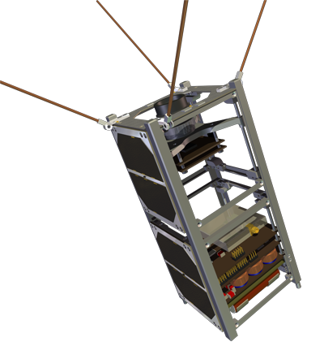
Introduction
PSAS/OreSat’s mission is to get a CubeSat into Lower Earth Orbit
Need for a device for command, control and communication (C3) between a CubeSat and a ground station
The code name for the module is Sputnik because of it's requirements to be a simple, reliable space system.
Notes:
Problem or Need : What is the problem being solved? Where does it arise?
→ Portland State Aerospace Society has a need of a device that can communication between a CubeSat and a ground Station. The commercial Boards
2

Slide 3

Motivation
Launch Oregon’s first small educational satellite (aka CubeSat)
Build the first and most important avionics modules for the CubeSat
NASA ELANA program

Slide 4
Objective
Rapidly prototype C3 Module that can
Handle long distance RF communications to and from a Low Earth Orbit
Controlling and communicating with a payload that is housed within the CubeSat
Notes:
What is the specific objective of this project?A design? Aworking prototype?
4

Slide 5
Bigger Picture
Building a C3 system from scratch to meet
The harsh environment of space
Compliance with governmental regulations
Programming the module to perform the aforementioned duties
Testing and verifying the device
Documentation
Adhering to the PSAS open-source standard

Slide 6
Requirements
Must
Environment
Use parts rated in an Industrial Operating Temperature Range (−40°C to 80°C)
Communication block ("radio")
Operate in the 70 cm band (436 to 438 MHz)
Use IARU specified frequency for RF comms and make appropriate changes if necessary
Meet FCC Amateur Radio Licensing requirements (Title 47 CFR part 97)
Meet 10km link budget
Have bidirectional communication interface to Payload via UART
Local storage for communication in/out queues
Energy storage
Use an energy storage system to power the modules when not in sunlight
Energy Switching/Control
Be able to seamlessly switch energy sources to the load (System Controller)
System controller ("Controller")
Radiation tolerant analogue "system watchdog" controller
Power switches to turn other blocks on and off
Monitor energy storage and energy harvesting systems (no)
Communication link with communication block (kind of)
CubeSat requirements
Conforms to latest CubeSat specification where applicable
Fits in 1/4 1U CubeSat
Weighs less than 250 g

Slide 7
Stretch Goals
Should
In general
Use as many COTS (Commercial Off The Shelf) parts as possible
Energy Storage
Monitor the state of charge of the battery
Voltage
Current
Charge (Coulombs)
Environment
Operate in the Automotive Operating Temperature Range (−40°C to 125°C)
Be able to operate in a near-perfect vacuum
Handle 15g in the "Z" axis
Communication block (“radio”)
Use a frequency of 436.5 MHz for RF communication
May
Environment
Operate in Military Operating Temperature Range (-55°C to 125°C)

Slide 8
Approach
Decided to have two separate modules that together make C3
LGR – Low Gain Radio
Communications pipeline
System controller
Receive and execute commands (Command/Control)
Divide and conquer!
LGR – Will, Jake
System Controller – Shan, Mike

Slide 9
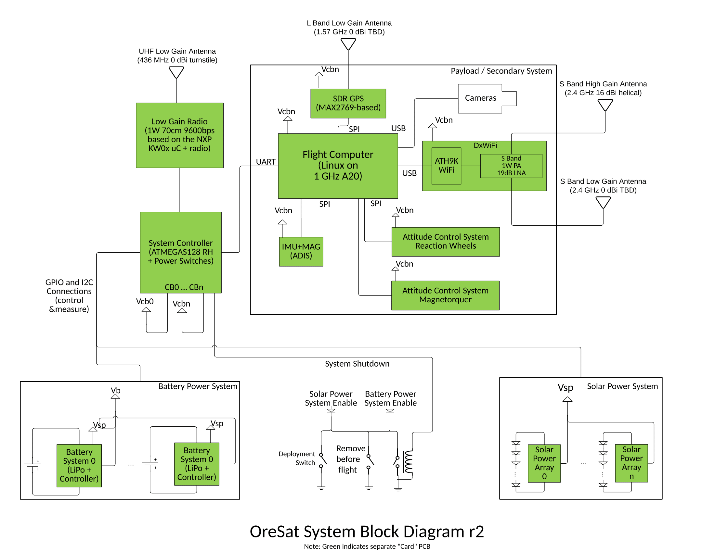
OreSat Low Level Diagram
Notes:
May need multiple subAheadings here (e.g. H/W and S/W, or multiple subsystems) Describe design using appropriate methods (e.g. UML models, algorithms) Discuss design alternatives, tradeAoffs, decisions made
9

Slide 10
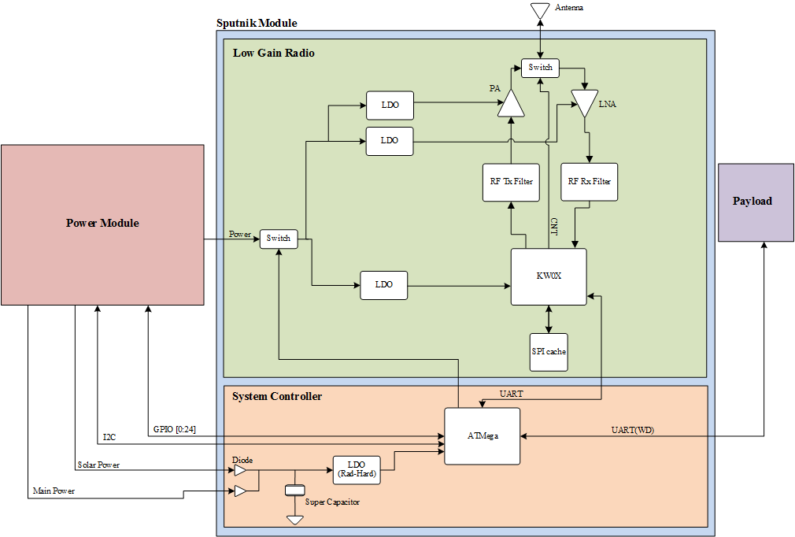
Sputnik Low Level Diagram
Notes:
May need multiple subAheadings here (e.g. H/W and S/W, or multiple subsystems) Describe design using appropriate methods (e.g. UML models, algorithms) Discuss design alternatives, tradeAoffs, decisions made
10

Slide 11
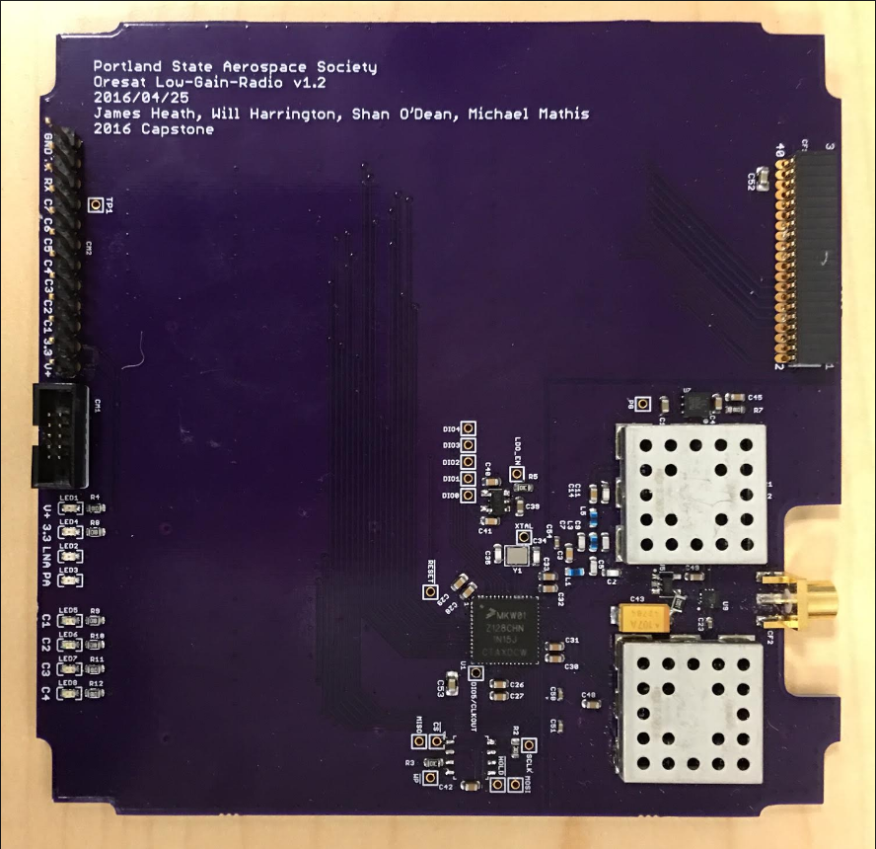
Low Gain Radio (LGR)
Definition
Purpose
Requirements
Block Diagram
Schematic
Layout
Firmware
Testing Results

Slide 12
LGR - Definition
Low-gain radios (LGRs) provide wide-angle coverage, but in turn have lower gain. LGRs are designed to be useable for relatively low data rates as long as the satellite is within line of sight of the receiver.
Low-gain so that we can control the CubeSat no matter what the orientation
Main communication pipeline for the satellite

Slide 13
LGR – Requirements
Operate in the 70 cm ISM band
436.5 MHz
Meet 400 km link budget
Need output power of up to 1 Watt
Adhere to FCC Amateur Radio Licensing requirements (Title 47 CFR part 97)
2nd Harmonic is less than 40dB of desired signal strength
Have bidirectional communication interface to system controller via UART
Local storage for communication in/out queues

Slide 14
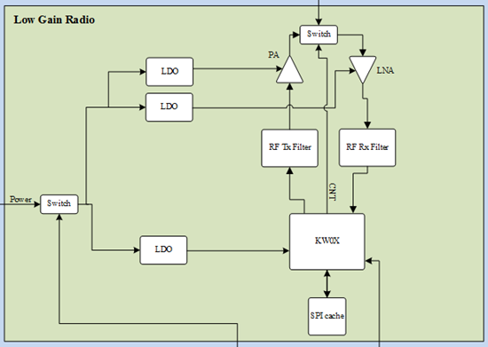
LGR - Block Diagram

Slide 15
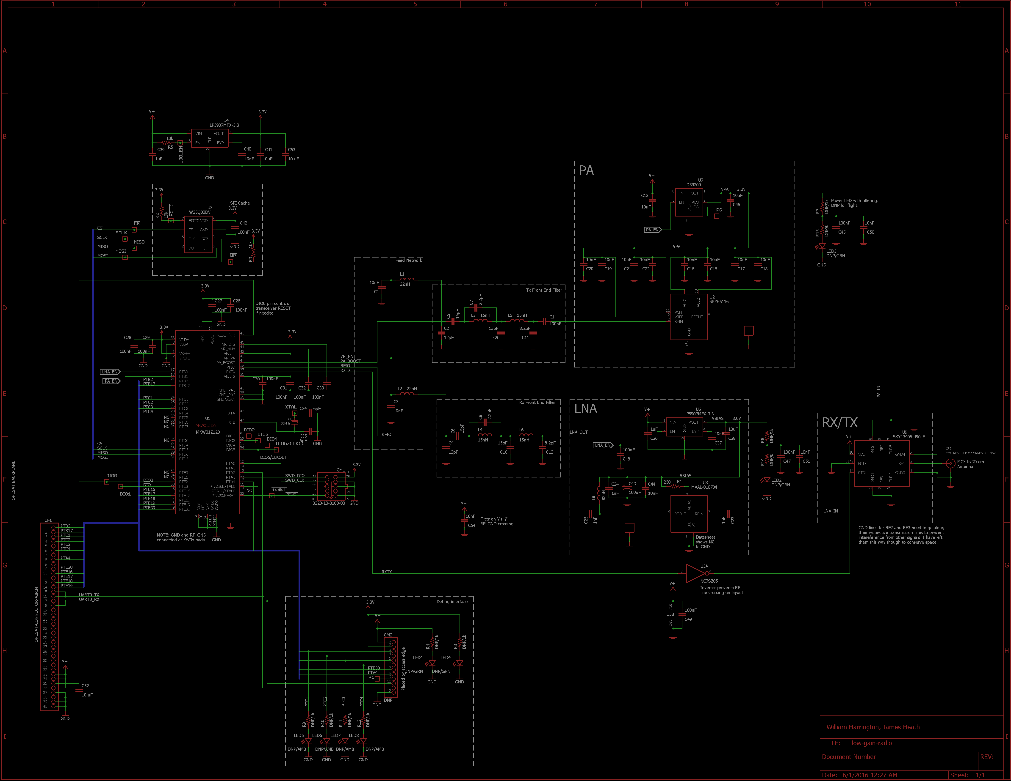
Implementation - LGR Schematic
Notes:
15

Slide 16
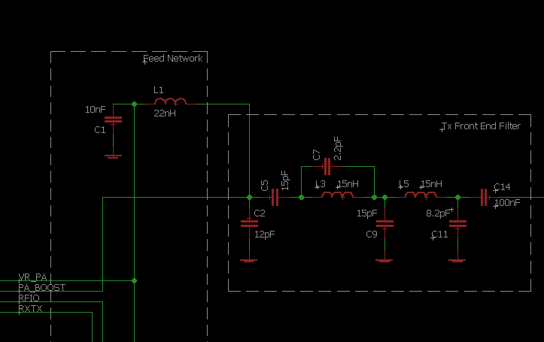
Schematic - Filter

Slide 17
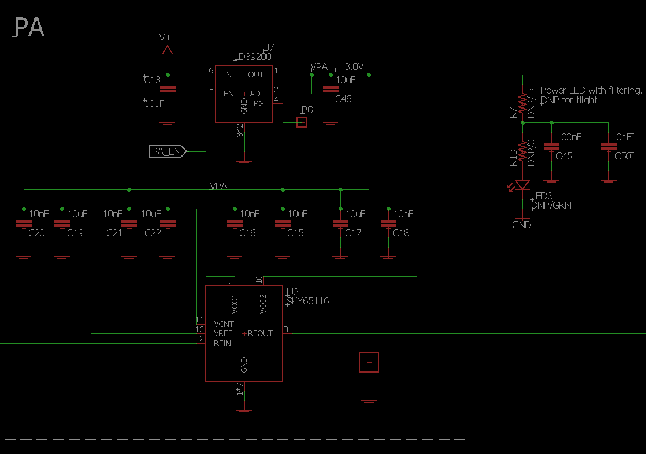
Implementation – PA Schematic

Slide 18
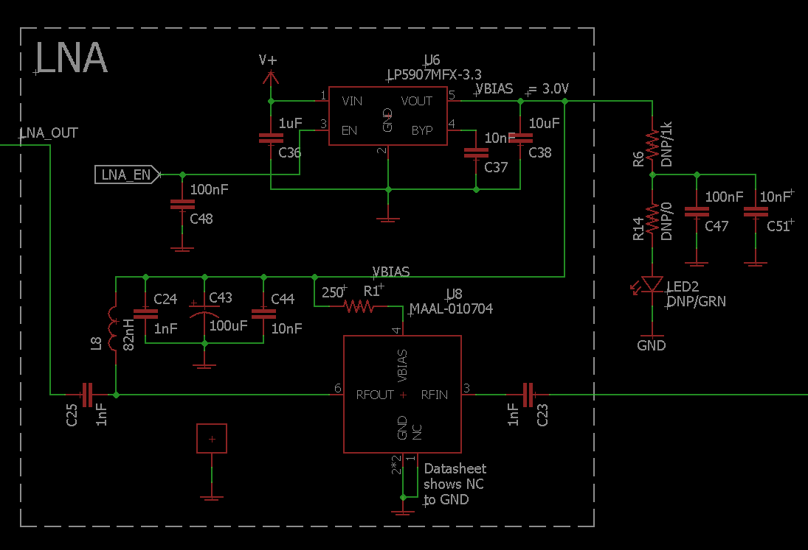
Implementation – LNA Schematic

Slide 19
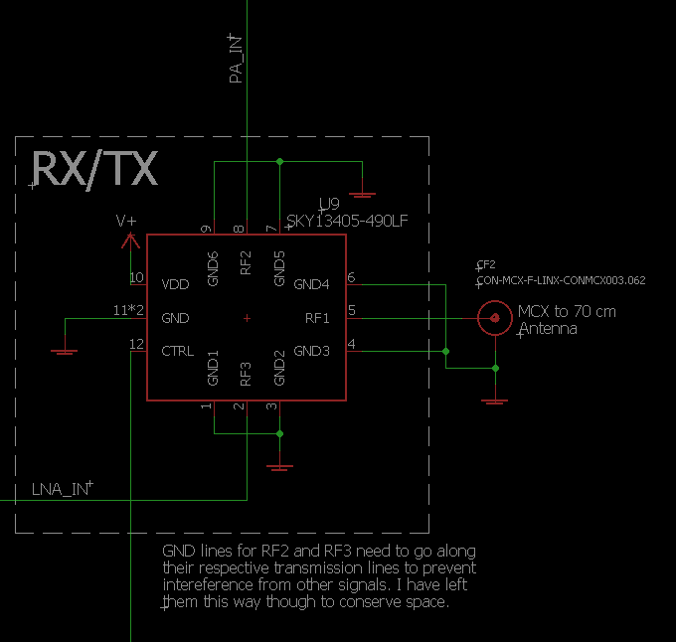
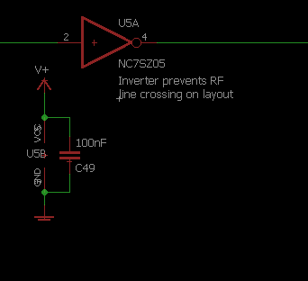
Schematic – RX/TX Switch

Slide 20
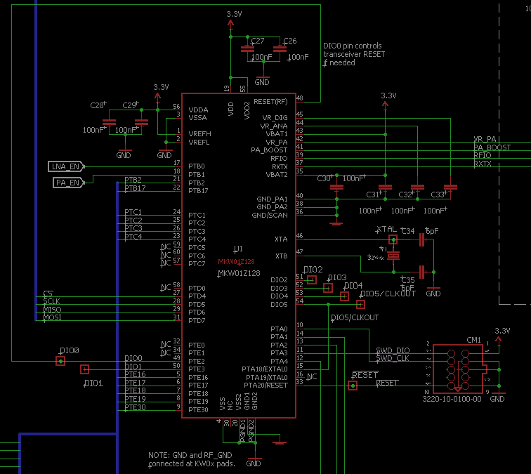
Schematic – MCU

Slide 21
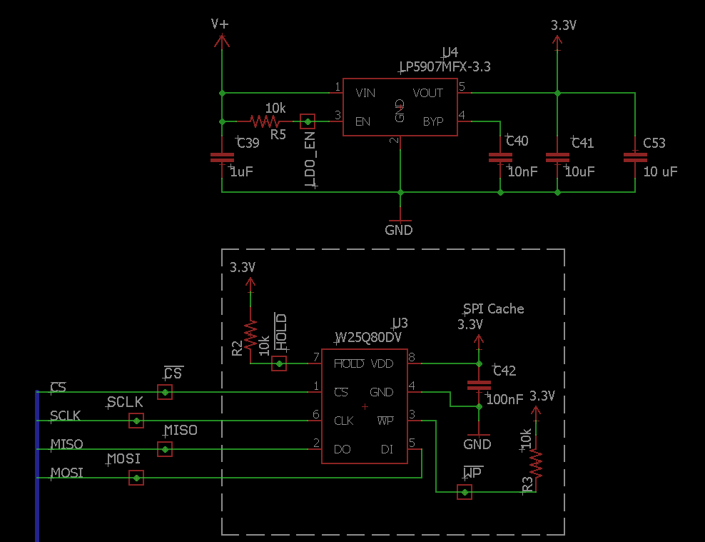
Schematic – SPI Cache/MCU LDO

Slide 22
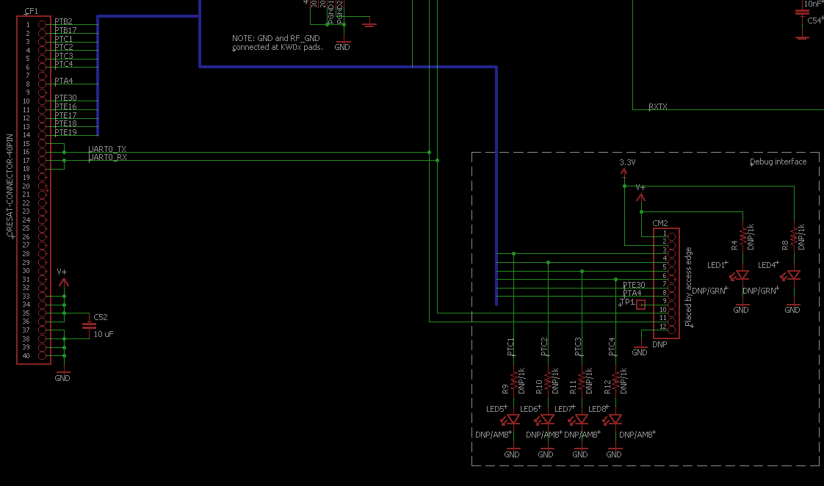
Schematic – Debug Pins

Slide 23
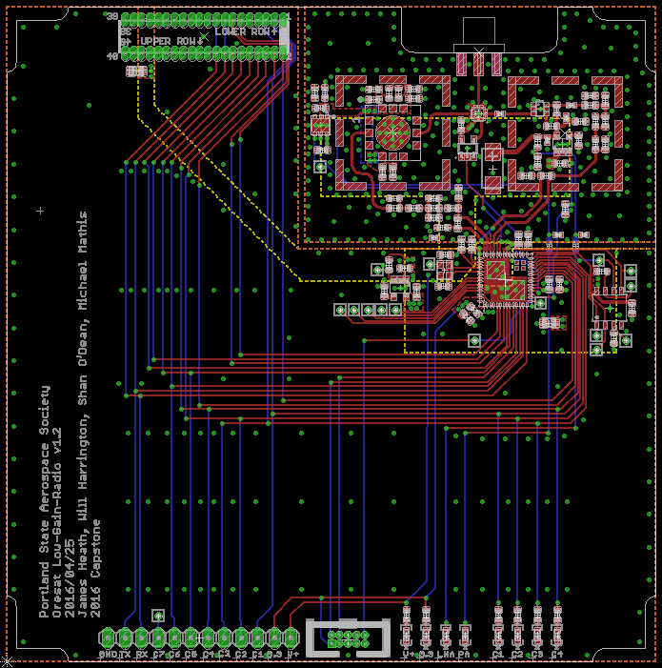
Board Layout (LGR)
Notes:
23

Slide 24
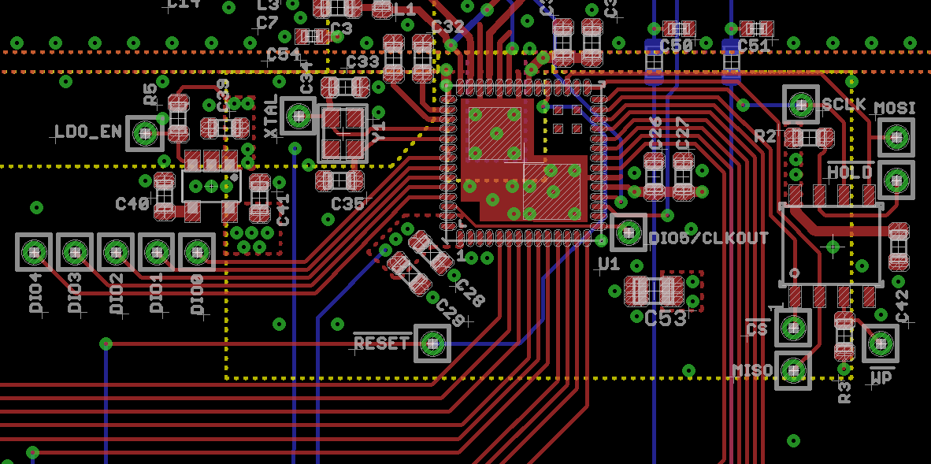
Layout - MCU/SPI Cache

Slide 25
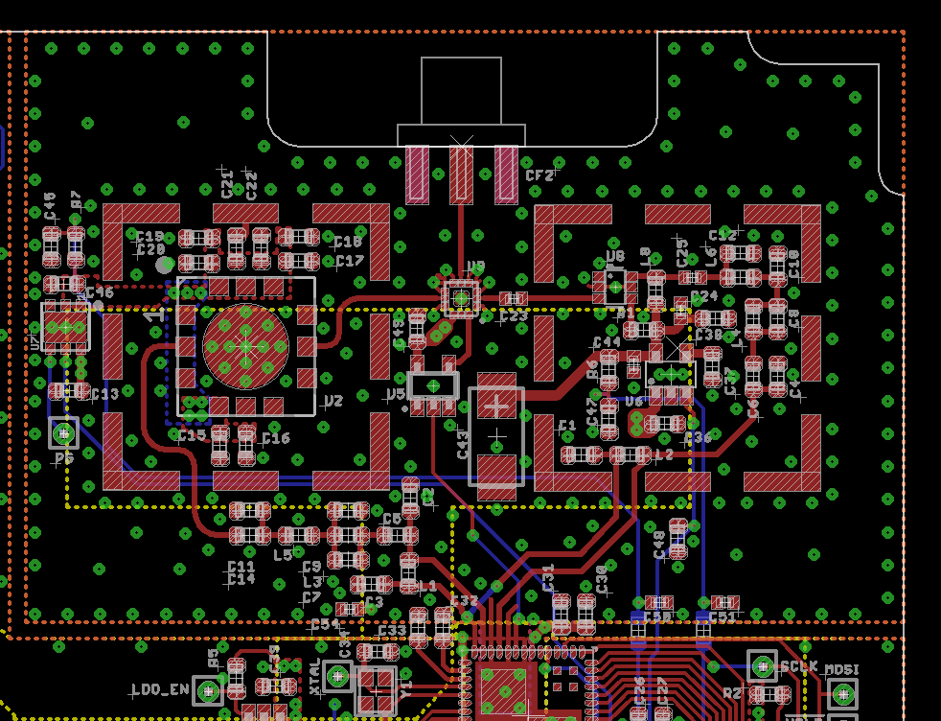
Layout - RF

Slide 26
LGR Firmware
Drivers
Clock
GPIO
SPI
UART
Transceiver
Main loop
RX/TX
Uses SPI
Print to UART
Blink LEDs

Slide 27
LGR Testing
Main Tests:
Supply Range Test
Ensure radio works over variable range from 3-5 V
Filter Tests
Practicum filters
Radio Test
Confirms radio is capable of transmitting and receiving
Functionality Test
Confirms radio transmission distance

Slide 28
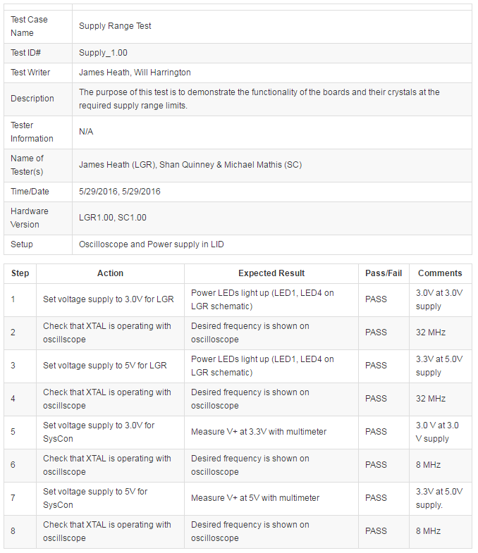
LGR – Supply Range Test

Slide 29
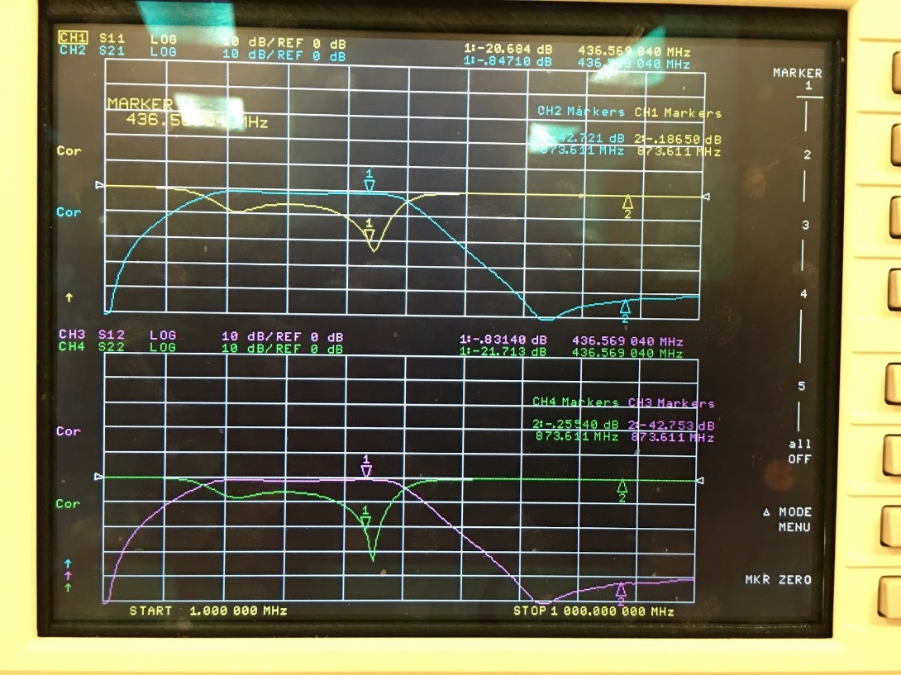
Filter Measurements

Slide 30
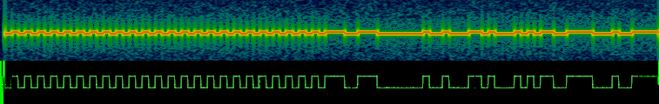
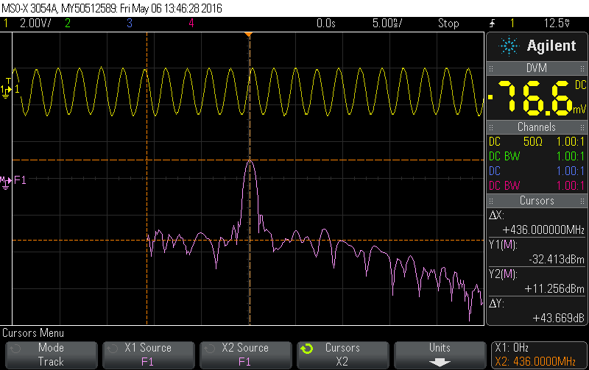
LGR - Radio Test

Slide 31
System Controller (SC)
Definition
Purpose
Main contributors
Requirements
Block Diagram
Schematic
Layout
Firmware
Testing Results

Slide 32

Purpose
The System Controller is entrusted to perform two main tasks that are essential to the success of the CubeSat. These include the task of system monitor (watchdog) and the task of power management.
The System Controller is the second of the two boards completed for the Sputnik C3 Capstone. It contains an ATMega128 microcontroller, optical isolation between itself and the LGR and FC boards, and the power management circuitry for the system.

Slide 33
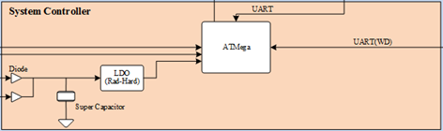
Block Diagram

Slide 34
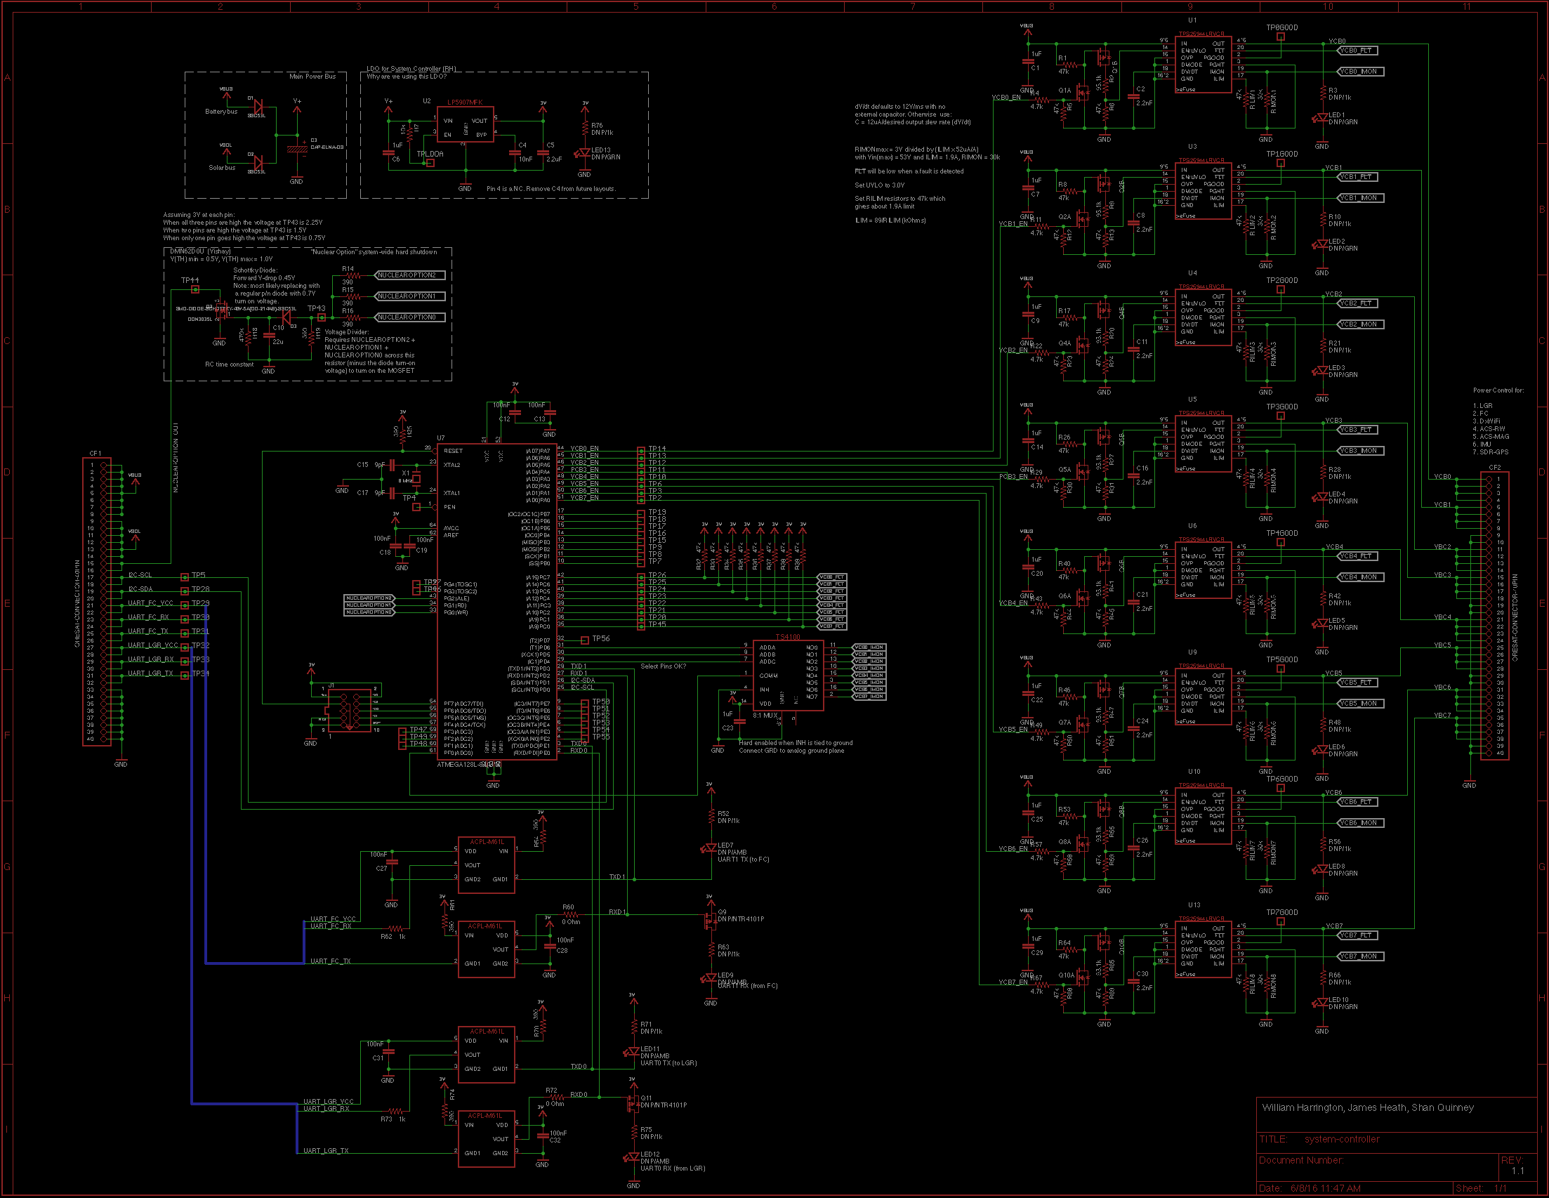
Implementation – SC Schematic
Notes:
34

Slide 35
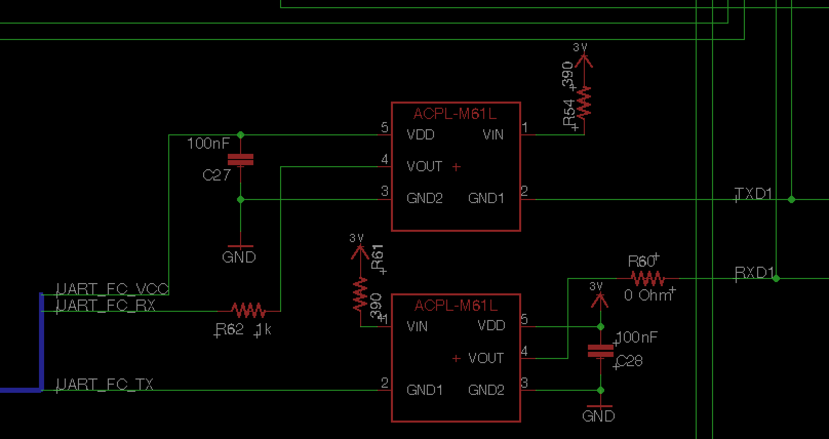
Implementation – Optoisolator Schematic

Slide 36
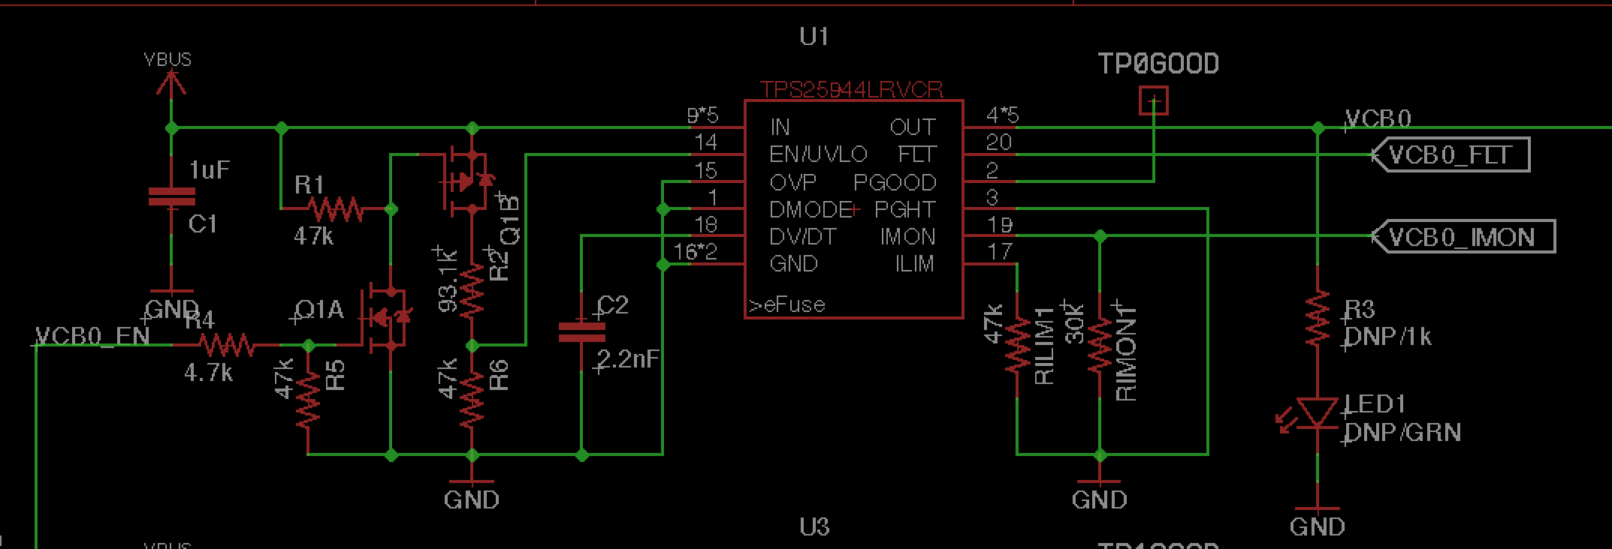
Implementation – eFuse Schematic

Slide 37
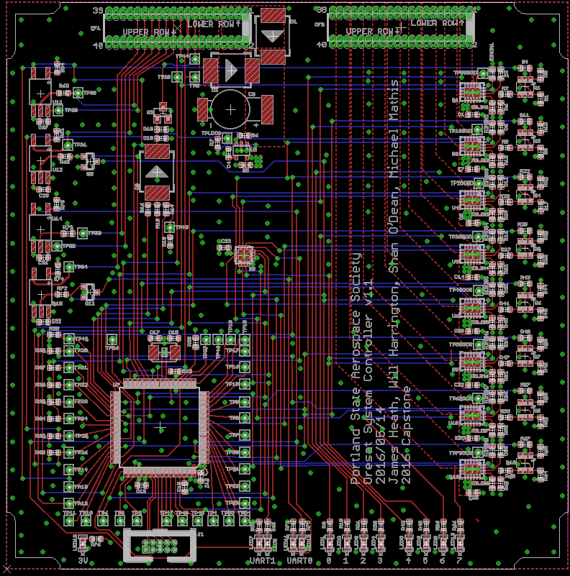
Board Layout (SC)
Notes:
37

Slide 38
System Controller Firmware
ATMega microcontrollers have a very developed driver ecosystem
The system controller listens on UART and I2C for status updates from the payload, LGR, and power system
If there is an error with module, possibly due to a radiation latch-up event, the system controller can power cycle each subsystem individually
If the power system needs to be reset, the system controller is powered by the on-board super capacitor. This can power the system controller for 15-30 seconds
When the system controller listens to the LGR it will also recognize commands sent from the ground station and execute them

Slide 39
SC Testing
Add SC testing video

Slide 40
Sputnik Functionality/Distance Test
Notes:
Example of System Testing
40

Slide 41
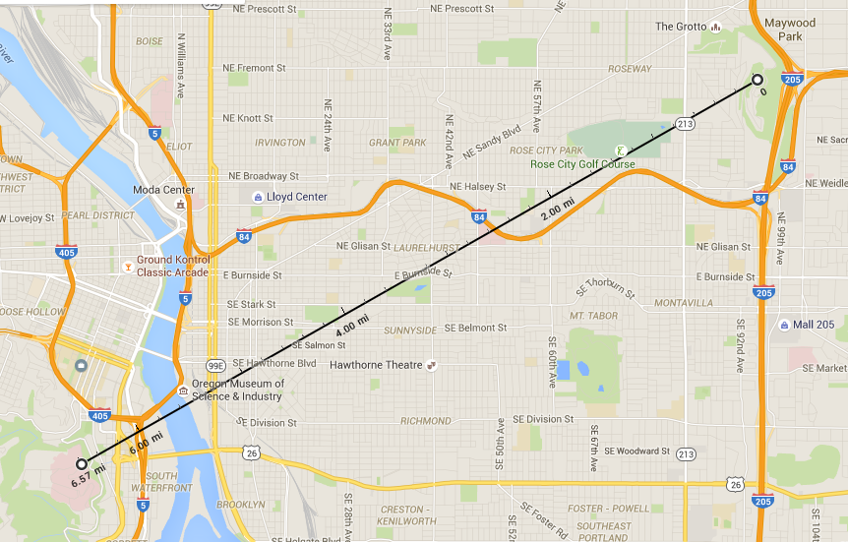
Distance
Total Distance:
10.57 km
Rocky
Butte
OHSU
Notes:
Example of Interface Testing
41

Slide 42
Test Setup
Pictures of testing and video
Notes:
Example of Interface Testing
42

Slide 43
Sputnik Test Results
Test | Result
Component Test | Passed
Supply Range Test | Passed
Radio Test | Passed
Command Test | Passed
Control Test | Passed
Final Test | Passed

Slide 44
Requirements with Results
Initial Requirements | Final Status | Completion
Parts temperature rated (-40 to 80C) | No change | Completed
Radio in 70cm band | No change | Completed
10km link budget | No change | Completed
Power without sunlight | No change | Completed
Energy source switching | No change | Completed
Environmental Tests (vacuum, temperature, acceleration) | Removed | N/A – The prototype will not be used in harsh environments
Radiation Tolerant Watchdog | No change | Completed
Power switches for other blocks | No change | Completed
Conforms to CubeSat standard | No change | Completed
Monitor Energy Storage | Removed | N/A - Power system management removed

Slide 45
Budget Up to $1000
Item | Cost
System Controller Stencil (2) | $33.46
Low-Gain-Radio Stencil (2) | $52.08
System Controller Parts (With Spares) | $307.96
Low Gain Radio Parts (With Spares) | $200.89
System Controller Board (3) | $153.70
Low Gain Radio Board (3) | $153.70
Total | $901.79

Slide 46
Impact
Open Source low-budget CubeSat project that can be used by smaller developing aerospace groups as a jump off point.
Also will be the first legible open source code for setting up the MCU on the LGR.
First CubeSat from Oregon to be apart of the NASA ELANA program.
Another step in a new direction of interest for PSAS.

Slide 47
Changes and Improvements
Get rid of Freescale/NXP MCU (maybe?). Texas Instruments has a good alternative that was vaporware at the beginning of the project.
Change the RF Switch to suit our layout needs better and get rid of the inverter.
Change MACOM LNA chip to a new Skyworks LNA that has better data within our frequency range.

Slide 48
Lessons Learned
Earlier hack sessions, saved too many difficult tasks for too late in the term
More communication between teams, particularly between hardware and firmware
Work on harder tasks together

Slide 49
IP and Prior Work
Datasheets
Freescale/NXP
Silicon Labs
Murata
Microchip Technology
Micrel
All open source
ATMega drivers from Peter Fleury
Notes:
Brief summarize what use you made of prior work or IP including but not limited to ideas, designs, schematics, board layouts, code.
49

Slide 50

Acknowledgments
Portland State University
Aerospace Society (PSAS)
Andrew
Glenn
Theo
Kenny
Jaime
Eric
Notes:
50

Slide 51
Q&A / DEMO

